Slide 1

Outlier Analysis
GOA COLLEGE OF ENGINEERING
Affiliated to Goa University
INFORMATION TECHNOLOGY DEPARTMENT
Vision
Impart high quality knowledge and skills to students in the field of Information Technology ,motivate research, encourage industry consultancy projects and nurture human values and life skills.
Prepared By,
Ms. Diana Miranda
Assistant Professor
Dept. of Information Technology
Goa College of Engineering

Slide 2
Outliers and Outlier Analysis

Slide 3
What are Outliers?
Y
A data object that deviates significantly from the normal objects as if it were generated by a different mechanism
N₁
o₁
O₃
o₂
N₂
X

Slide 4
Outliers and Noise
Outliers are different from the noise data
Noise is random error or variance in a measured variable
Noise should be removed before outlier detection
Outliers are interesting: It violates the mechanism that generates the normal data
Outlier detection vs. novelty detection: early stage, outlier; but later merged into the model

Slide 5
Types of Outliers
Global Outliers
Contextual Outliers
Collective Outliers

Slide 6
Global Outliers
Data Object deviates significantly from the rest of the dataset
Also called point anomalies
Most outlier detection algorithms focus on this type of outliers
Critical issue: Find an appropriate measurement of deviation w.r.t. the application

Slide 7
Contextual Outliers
Data Object deviates significantly w.r.t. a specific context of the object
Also called conditional outliers because they are conditional on the selected context
Context has to be specified as part of the problem
Attributes of the data objects in question are divided into 2 groups:
Contextual attributes: defines the context
Behavioral attributes: characteristics of the object used in outlier evaluation
Can be viewed as a generalization of local outliers—whose density significantly deviates from its local area
Issue: How to define or formulate meaningful context?

Slide 8
Collective Outliers
A subset of data objects collectively deviate significantly from the whole data set, even if the individual data objects may not be outliers
Detection of collective outliers
Consider not only behavior of individual objects, but also that of groups of objects
Need to have the background knowledge on the relationship among data objects, such as a distance or similarity measure on objects.

Slide 9
Challenges of Outlier Detection
Modeling normal objects and outliers properly
Building a comprehensive model for data normality is very challenging
Hard to enumerate all possible normal behaviors in an application
The border between normal and outlier objects is often a gray area
Some assign labels (“normal” or “outlier”) while others assign a score measuring the “outlierness”
Application-specific outlier detection
Choice of distance measure among objects and the model of relationship among objects are often application-dependent
Impossible to develop a universally applicable outlier detection method
9

Slide 10
Challenges of Outlier Detection
Handling noise in outlier detection
Noise may be present as deviations in attribute values or even missing values
Noise may distort the normal objects and blur the distinction between normal objects and outliers.
Noise help “hide” outliers
Outliers may be “disguised” as noise
Understandability
Users may want to understand why the detected objects are outliers
Outlier detection method must provide some justification of the detection
10

Slide 11
Outlier Detection Methods

Slide 12
2 types of Classification
Supervised, Semi-Supervised and Unsupervised Methods
Depends on whether experts labeled examples of normal and outlier objects are available
Statistical Methods, Proximity-Based Methods and Clustering Based Methods

Slide 13
Supervised, Semi-Supervised and Unsupervised Methods
Supervised Methods
Domain experts examine and label a sample of the underlying data
Task is to learn a classifier that can recognize outliers
Challenges:
Class Imbalance between normal data and outliers
In many applications, catching as many outliers as possible (sensitivity or recall of outlier detection) is far more important than mislabelling objects as outliers

Slide 14
Supervised, Semi-Supervised and Unsupervised Methods
Unsupervised Methods
Normal objects are somewhat clustered
An outlier is expected to occur far away in the feature space from any of those groups of normal objects
This assumption may not always be true:
Normal objects may be uniformly distributes.
Collective outliers share high similarity in a small area
Many clustering methods can be adapted to act as unsupervised outlier detection methods
Such methods suffer from 2 issues:
Confusion between noise and outlier
High cost of clustering

Slide 15
Supervised, Semi-Supervised and Unsupervised Methods
Semi-Supervised Methods
Amount of labelled data is limited
Labelled normal objects along with nearby unlabelled objects are used to train a model for recognizing normal objects
All objects not fitting the model are classified as outliers
Tricky because a small set of labelled outliers may not represent all the possible outliers
To improve performance: use help of models learned from unsupervised methods

Slide 16
Statistical Methods, Proximity-Based Methods and Clustering Based Methods
Statistical Methods
Also called model based methods
Make assumptions of data normality
Assume that normal data objects are generated by statistical models
Data not following the model are outliers
Effectiveness depends on whether the assumption holds true for the given data or not
2 types of statistical methods:
Parametric
Non-Parametric

Slide 17
Statistical Methods, Proximity-Based Methods and Clustering Based Methods
Proximity-Based Methods
Object is an outlier if its nearest neighbours are far away in feature space
Effectiveness relies heavily on the proximity measures used
2 types:
Distance Based
Density Based

Slide 18
Statistical Methods, Proximity-Based Methods and Clustering Based Methods
Clustering Based Methods
Assume that normal data objects belong to large dense clusters
Outliers belong to small or sparse clusters or do not belong to any cluster
Clustering is an expensive operation

Slide 19
Applications

Slide 20

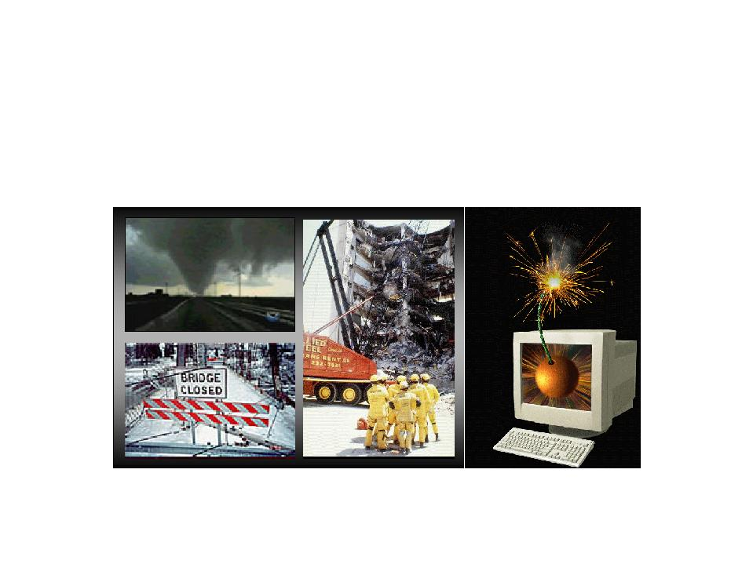
Intrusion Detection
Intrusion Detection:
Process of monitoring the events occurring in a computer system or network and analyzing them for intrusions
Intrusions are defined as attempts to bypass the security mechanisms of a computer or network ‏
Challenges
Traditional signature-based intrusion detection systems are based on signatures of known attacks and cannot detect emerging cyber threats

Slide 21
Fraud Detection
Fraud detection refers to detection of criminal activities occurring in commercial organizations
Malicious users might be the actual customers of the organization or might be posing as a customer (also known as identity theft).
Types of fraud
Credit card fraud
Insurance claim fraud
Mobile / cell phone fraud
Insider trading
Challenges
Fast and accurate real-time detection
Misclassification cost is very high

Slide 22

Healthcare Informatics
Detect anomalous patient records
Indicate disease outbreaks, instrumentation errors, etc.
Key Challenges
Only normal labels available
Misclassification cost is very high
Data can be complex: spatio-temporal

Slide 23
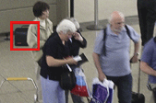
Image Processing
Detecting outliers in a image monitored over time
Detecting anomalous regions within an image
Used in
mammography image analysis
video surveillance
satellite image analysis
Key Challenges
Detecting collective anomalies
Data sets are very large
Anomaly

Slide 24
Statistical Approaches

Slide 25
General Idea: To learn a generative model fitting the given dataset, and then identify those objects in low probability regions of the model as outliers
Can be divided into parametric and non-parametric approaches

Slide 26
Parametric
Univariate Outliers
Multivariate Outliers
Non-Parametric
Histogram
Maximum Likelihood Method
Grubb’s Test
Using Mahalanobis Distance
Using $χ^{2}$Distance
Using 𝜒^2 Distance
Mixture of Parametric Distributions
Multiple Parametric Distributions
Multiple Clusters

Slide 27
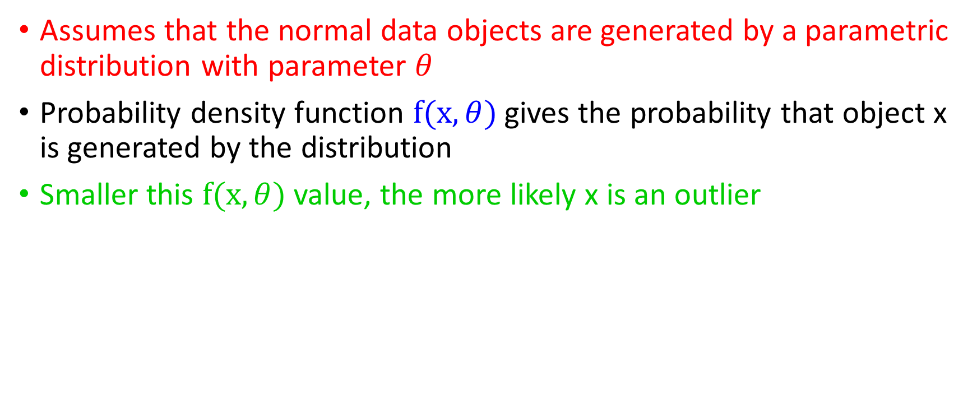
Parametric Methods
Assumes that the normal data objects are generated by a parametric distribution with parameter $θ$
Probability density function $f(x,θ)$ gives the probability that object x is generated by the distribution
Smaller this $f(x,θ)$ value, the more likely x is an outlier

Slide 28
Detection of Univariate Outliers Based on Normal Distribution
What is Univariate Data?
Univariate data: Data involving only 1 attribute
For simplicity: Choose to assume that the data comes from a normal distribution
Points with low probability are identified as outliers

Slide 29
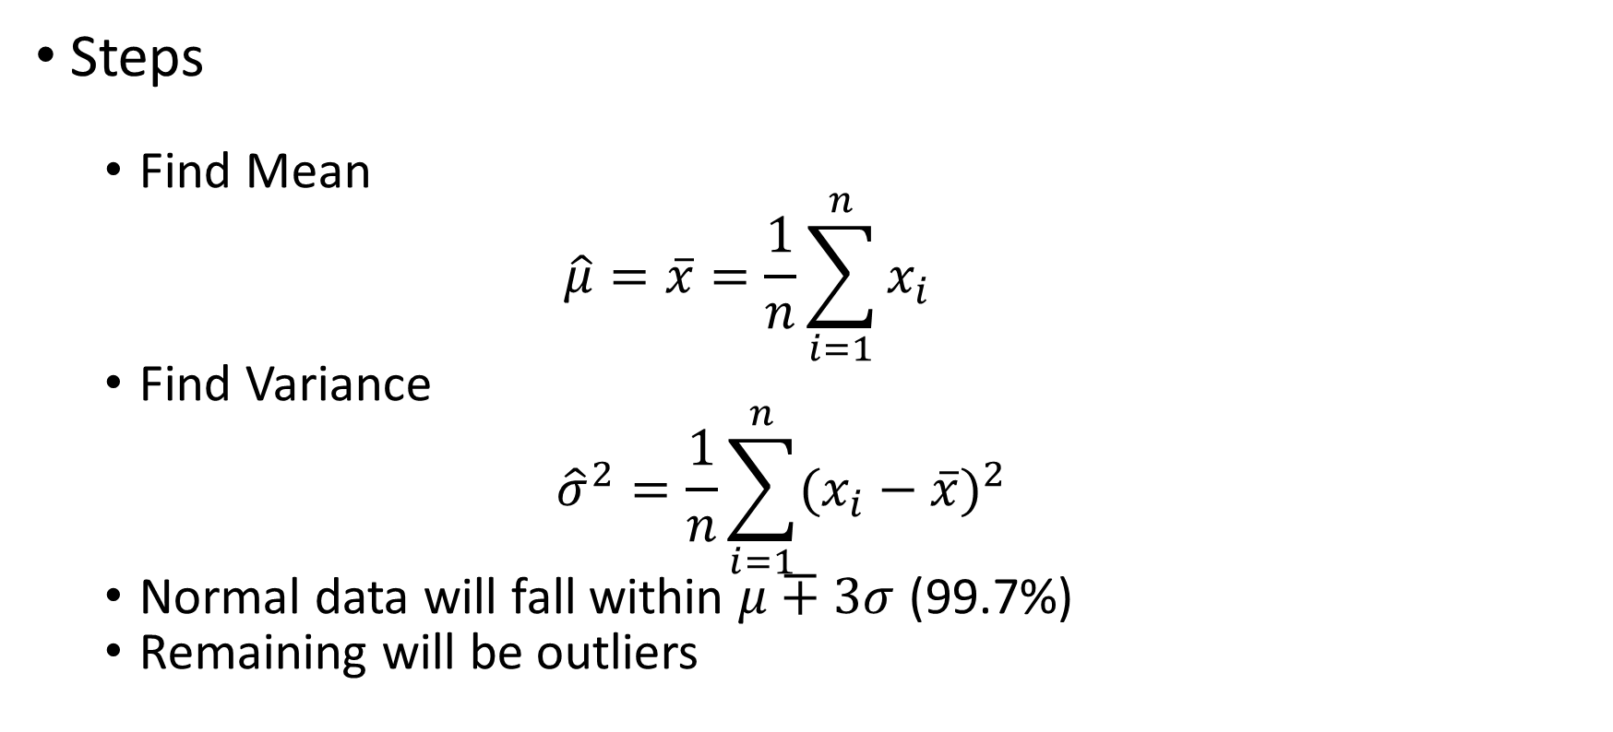
Maximum Likelihood Method
Steps
Find Mean
$$\hat{μ}=\overline{x}=\frac{1}{n}\sum_{i=1}^{n}{x_{i}}$$
Find Variance
$${\hat{σ}}^{2}=\frac{1}{n}\sum_{i=1}^{n}{{(x_{i}−\overline{x})}^{2}}$$
Normal data will fall within $μ∓3σ$ (99.7%)
Remaining will be outliers

Slide 30
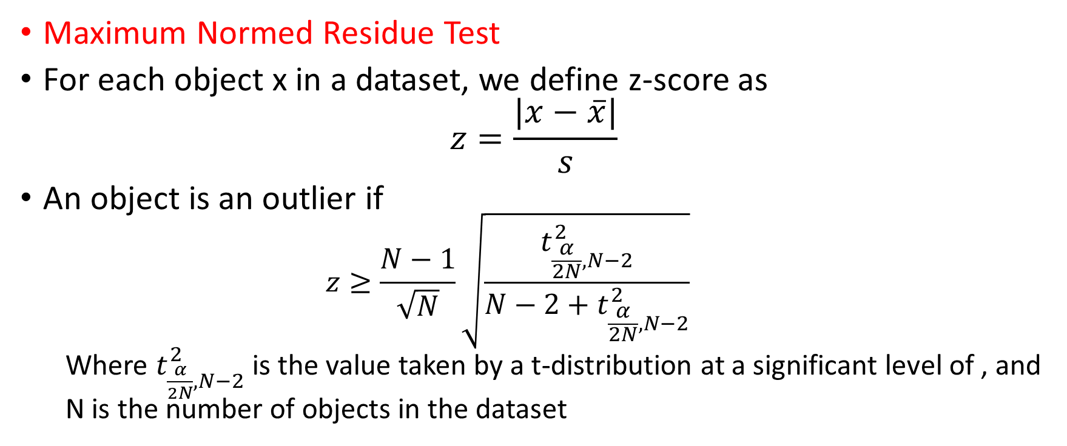
Grubb’s Test
Maximum Normed Residue Test
For each object x in a dataset, we define z-score as
$$z=\frac{|x−\overline{x}|}{s}$$
An object is an outlier if
$$z≥\frac{N−1}{\sqrt{N}}\sqrt{\frac{t_{\frac{α}{2N},N−2}^{2}}{N−2+t_{\frac{α}{2N},N−2}^{2}}}$$
Where $t_{\frac{α}{2N},N−2}^{2}$ is the value taken by a t-distribution at a significant level of , and N is the number of objects in the dataset

Slide 31
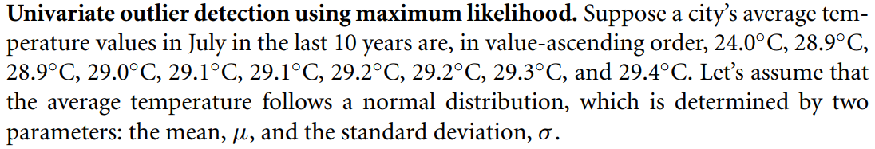
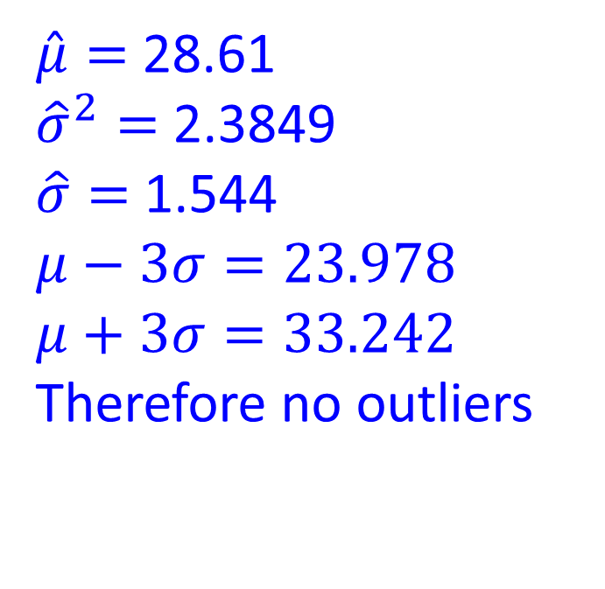
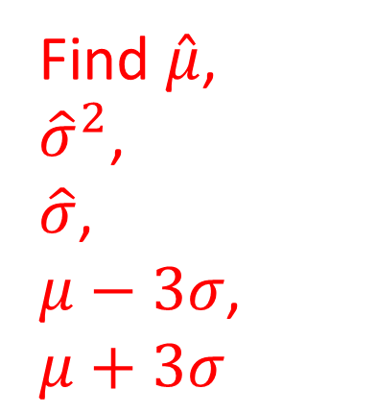
$\hat{μ}=$ 28.61
${\hat{σ}}^{2}=$ 2.3849
$\hat{σ}=$ 1.544
$$μ−3σ=23.978$$
$$μ+3σ=33.242$$
Therefore no outliers
Find $\hat{μ}$,
${\hat{σ}}^{2}$,
$\hat{σ}$,
$μ−3σ$,
$$μ+3σ$$

Slide 32
Detection of Multivariate Outliers
Multivariate Outliers: Data with two or more attributes

Slide 33
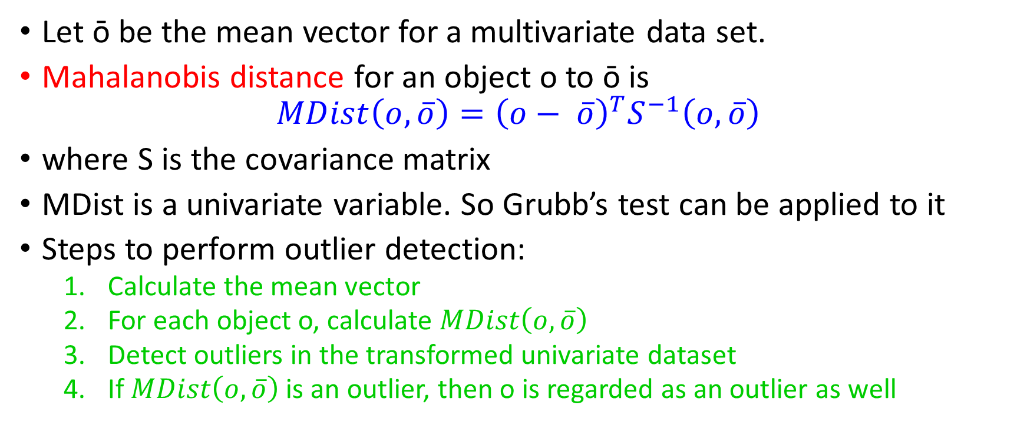
Using Mahalanobis Distance
Let ō be the mean vector for a multivariate data set.
Mahalanobis distance for an object o to ō is
$$MDist\left(o, \overline{o}\right)={\left(o− \overline{o}\right)}^{T}S^{−1}\left(o, \overline{o}\right)$$
where S is the covariance matrix
MDist is a univariate variable. So Grubb’s test can be applied to it
Steps to perform outlier detection:
Calculate the mean vector
For each object o, calculate $MDist\left(o, \overline{o}\right)$
Detect outliers in the transformed univariate dataset
If $MDist\left(o, \overline{o}\right)$ is an outlier, then o is regarded as an outlier as well

Slide 34
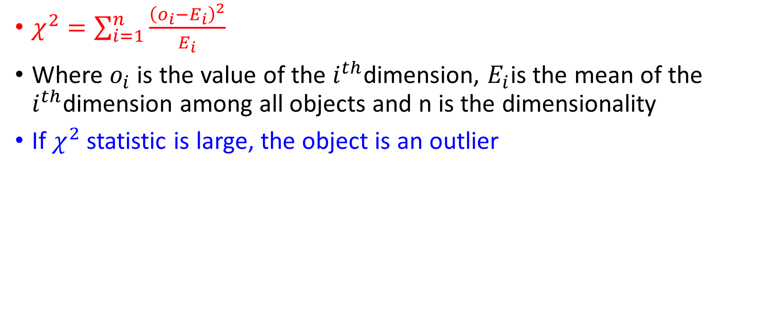

Using $χ^{2}$Statistic
$χ^{2}=\sum_{i=1}^{n}{\frac{{\left(o_{i}−E_{i}\right)}^{2}}{E_{i}}}$
Where $o_{i}$ is the value of the $i^{th}$dimension, $E_{i}$is the mean of the $i^{th}$dimension among all objects and n is the dimensionality
If $χ^{2}$ statistic is large, the object is an outlier

Slide 35
Using a Mixture of Parametric Distributions
Assumption of data being generated by a normal distribution may be overly simplified, when the actual data distribution is complex
In such cases, we assume that the data were generated by a mixture of parametric distributions

Slide 36
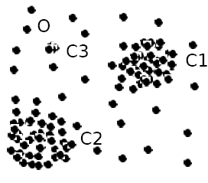
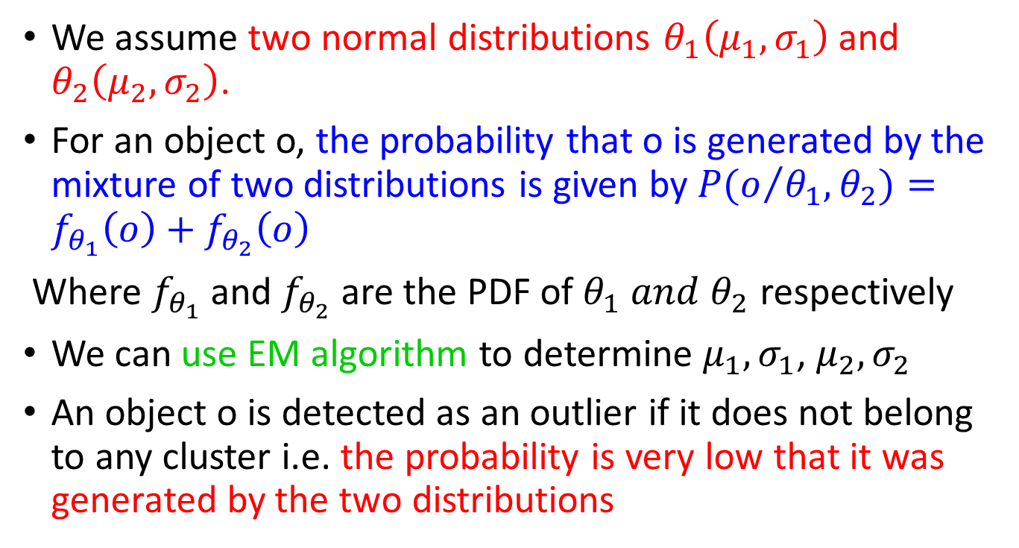
Using Multiple Parametric Distributions
We assume two normal distributions $θ_{1}\left(μ_{1},σ_{1}\right)$and $θ_{2}\left(μ_{2},σ_{2}\right)$.
For an object o, the probability that o is generated by the mixture of two distributions is given by $P(o/{θ_{1},θ_{2}})=f_{θ_{1}}\left(o\right)+f_{θ_{2}}\left(o\right)$
Where $f_{θ_{1}}$ and $f_{θ_{2}}$ are the PDF of $θ_{1} and θ_{2}$ respectively
We can use EM algorithm to determine $μ_{1},σ_{1}$, $μ_{2},σ_{2}$
An object o is detected as an outlier if it does not belong to any cluster i.e. the probability is very low that it was generated by the two distributions

Slide 37
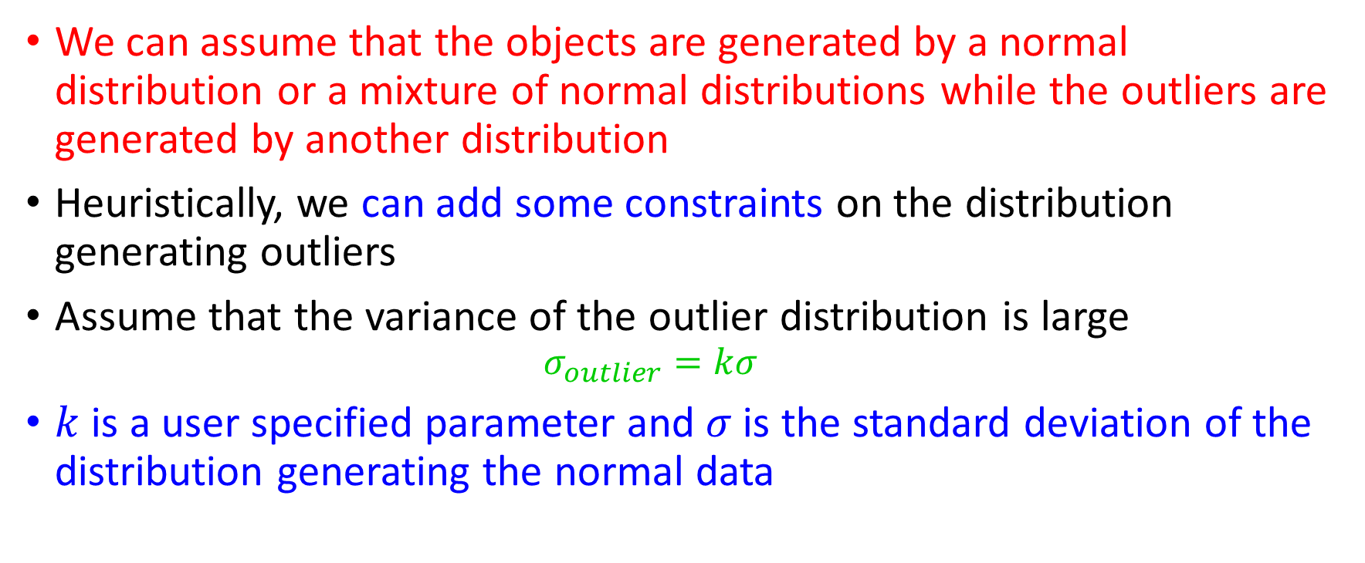
Using Multiple Clusters
We can assume that the objects are generated by a normal distribution or a mixture of normal distributions while the outliers are generated by another distribution
Heuristically, we can add some constraints on the distribution generating outliers
Assume that the variance of the outlier distribution is large
$$σ_{outlier}=kσ$$
$k$ is a user specified parameter and $σ$is the standard deviation of the distribution generating the normal data

Slide 38
Non-Parametric Methods
Model of normal data is learned from the input data rather than assuming one apriori
Makes fewer assumptions about the data
Applicable to more scenarios

Slide 39
Using a Histogram
Steps
Construct the histogram using some user specified parameters like width or number of bins
If the object falls in one of the bins, it is considered as normal. Otherwise, it is considered as an outlier
More sophisticated method: Object’s outlier score is the inverse of the volume of the bin to which it belongs to
What are the drawbacks of this method?
Drawback:
Hard to choose an appropriate bin size
Too small:
High false positive rate and low precision
Too large:
High false negative rate and low recall

Slide 40
Solution to bin size problem:
Adopt kernel density estimation to estimate the probability density distribution of the data.
If the estimated density function is high, the object is likely normal. Otherwise, it is likely an outlier.

Slide 41
Discussion of Statistical Methods
Advantage
Statistically justifiable (True only if the underlying assumption is true)
Computation Costs
Parametric Methods: Linear
EM Algorithm: Takes several iterations, each of which is linear
Kernel Density Estimation: Quadratic

Slide 42
Proximity Based Approaches

Slide 43
Assume that the proximity of an outlier to its nearest neighbours differs significantly from the proximity of a normal object to other objects in the dataset
2 types:
Distance Based: An object is identified as an outlier if the neighbourhood does not have enough other points
Density Based: An object is identified as an outlier if its density is relatively much lower than that of its neighbours

Slide 44
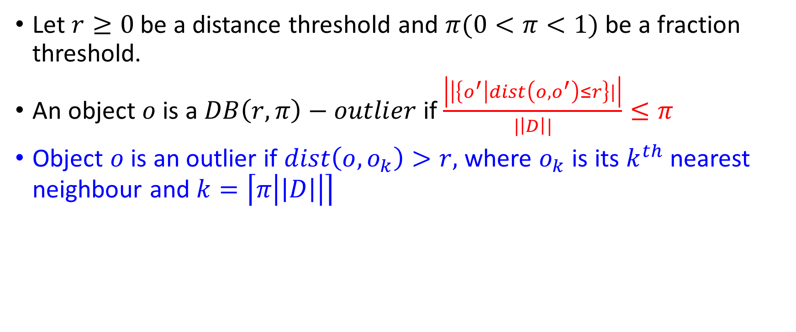
Distance Based Outlier Detection and a Nested Loop Method
Let $r≥0$be a distance threshold and $π(0<π<1)$ be a fraction threshold.
An object $o$ is a $DB\left(r,π\right)−outlier$ if $\frac{\left|\left|\left\{o^{′}\right|dist\left(o,o^{′}\right)≤r\right\}|\right|}{|\left|D\right||}≤π$
Object $o$ is an outlier if $dist\left(o,o_{k}\right)>r,$ where $o_{k}$ is its $k^{th}$ nearest neighbour and $k=\left\lceil π\left|\left|D\right|\right|\right\rceil$

Slide 45
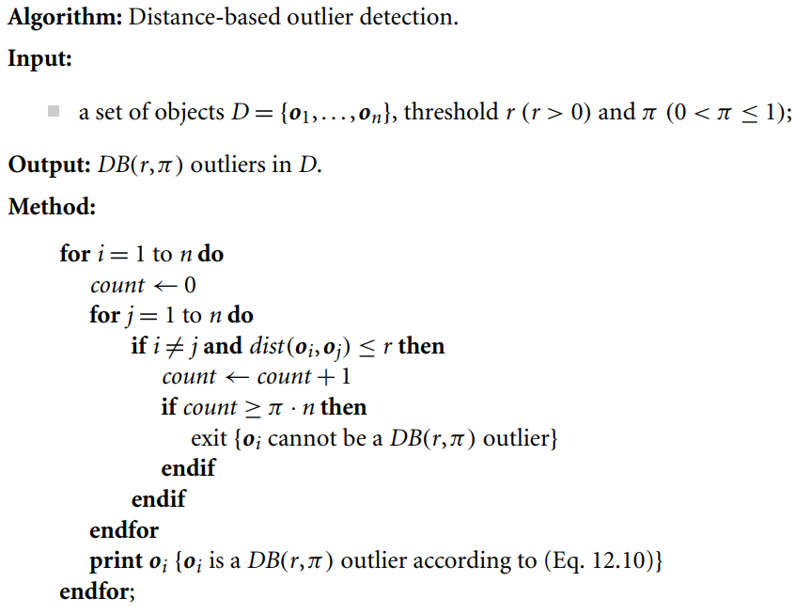

Slide 46
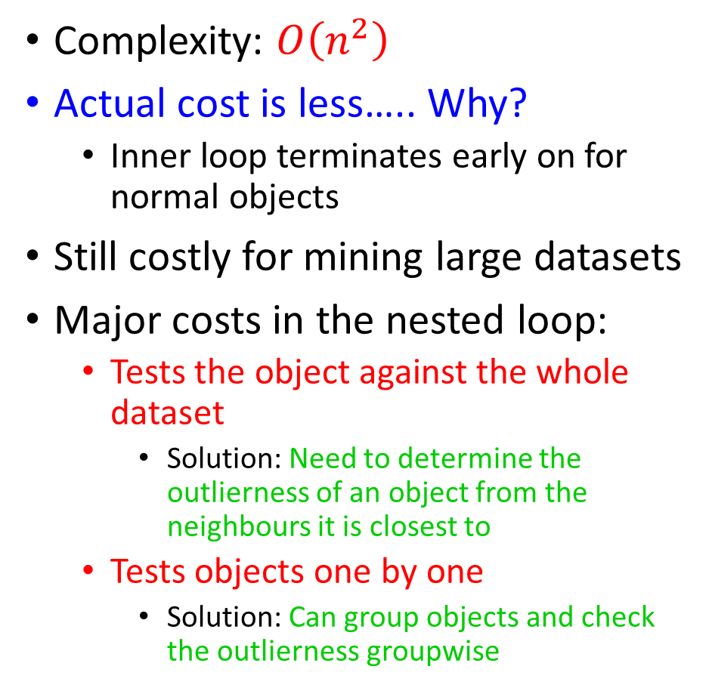
Complexity: $O\left(n^{2}\right)$
Actual cost is less….. Why?
Inner loop terminates early on for normal objects
Still costly for mining large datasets
Major costs in the nested loop:
Tests the object against the whole dataset
Solution: Need to determine the outlierness of an object from the neighbours it is closest to
Tests objects one by one
Solution: Can group objects and check the outlierness groupwise

Slide 47
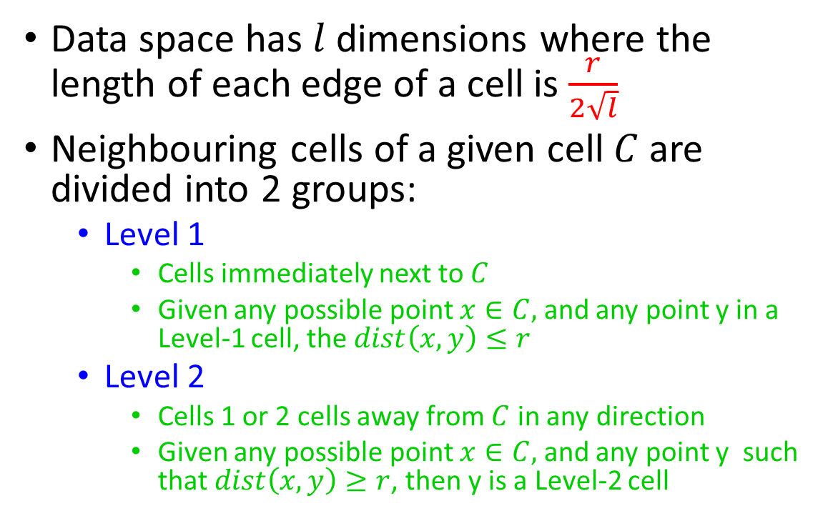
Grid Based Approach
Data space has $l$dimensions where the length of each edge of a cell is $\frac{r}{2\sqrt{l}}$
Neighbouring cells of a given cell $C$ are divided into 2 groups:
Level 1
Cells immediately next to $C$
Given any possible point $x∈C,$ and any point y in a Level-1 cell, the $dist\left(x,y\right)≤r$
Level 2
Cells 1 or 2 cells away from $C$ in any direction
Given any possible point $x∈C,$ and any point y such that $dist\left(x,y\right)≥r$, then y is a Level-2 cell

Slide 48
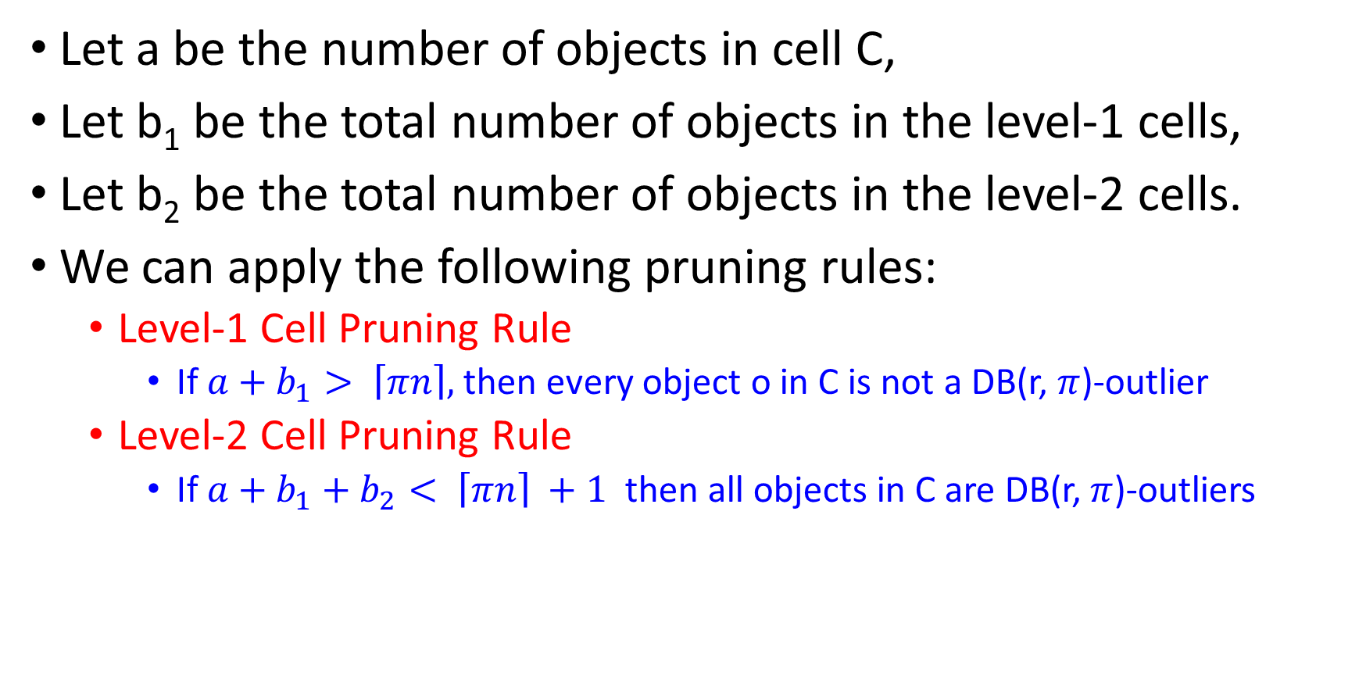
Let a be the number of objects in cell C,
Let b₁ be the total number of objects in the level-1 cells,
Let b₂ be the total number of objects in the level-2 cells.
We can apply the following pruning rules:
Level-1 Cell Pruning Rule
If $a+b_{1}> \left\lceil πn\right\rceil ,$ then every object o in C is not a DB(r, $π$)-outlier
Level-2 Cell Pruning Rule
If $a+b_{1}+b_{2}< \left\lceil πn\right\rceil +1$ then all objects in C are DB(r, $π$)-outliers

Slide 49
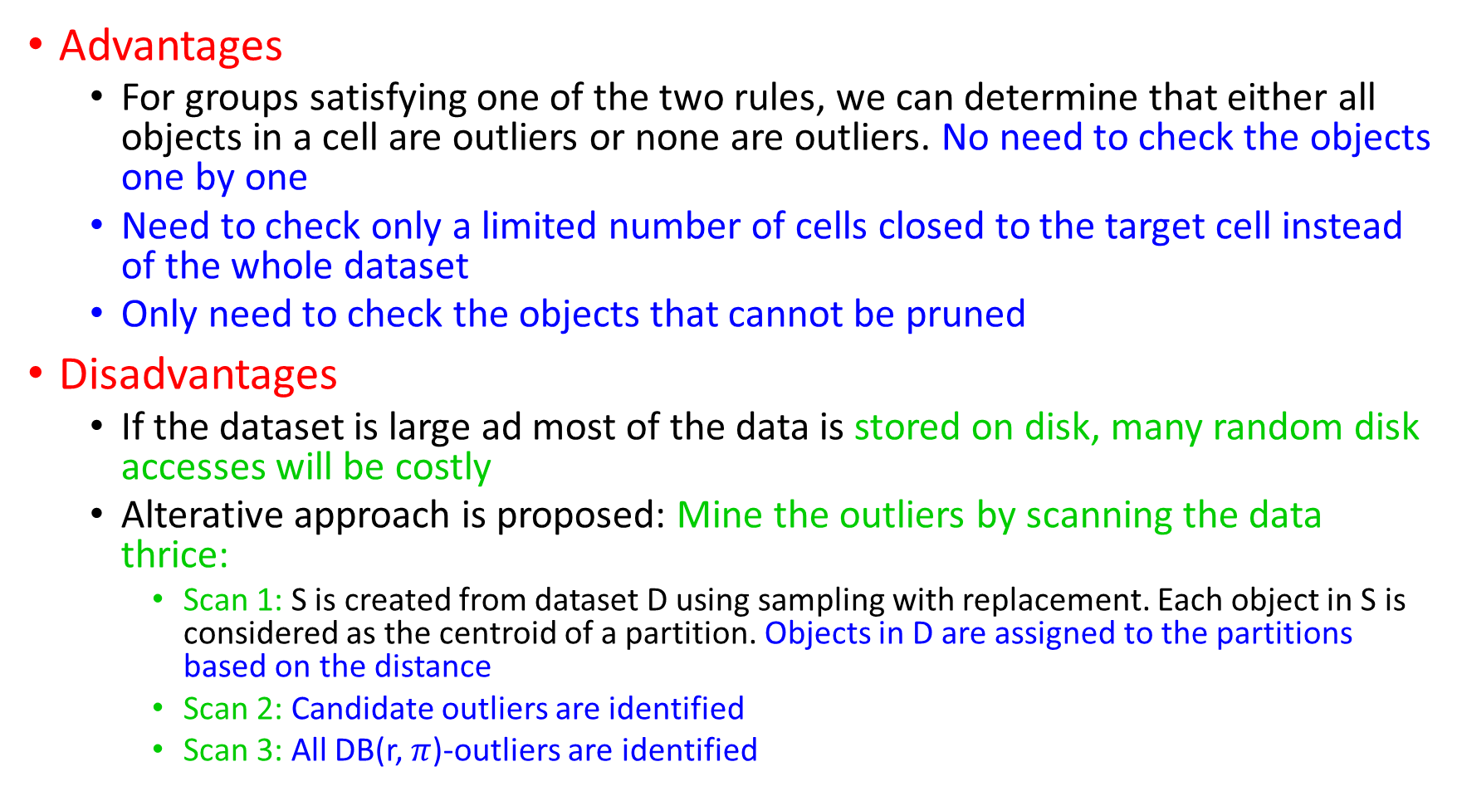
Advantages
For groups satisfying one of the two rules, we can determine that either all objects in a cell are outliers or none are outliers. No need to check the objects one by one
Need to check only a limited number of cells closed to the target cell instead of the whole dataset
Only need to check the objects that cannot be pruned
Disadvantages
If the dataset is large ad most of the data is stored on disk, many random disk accesses will be costly
Alterative approach is proposed: Mine the outliers by scanning the data thrice:
Scan 1: S is created from dataset D using sampling with replacement. Each object in S is considered as the centroid of a partition. Objects in D are assigned to the partitions based on the distance
Scan 2: Candidate outliers are identified
Scan 3: All DB(r, $π$)-outliers are identified

Slide 50
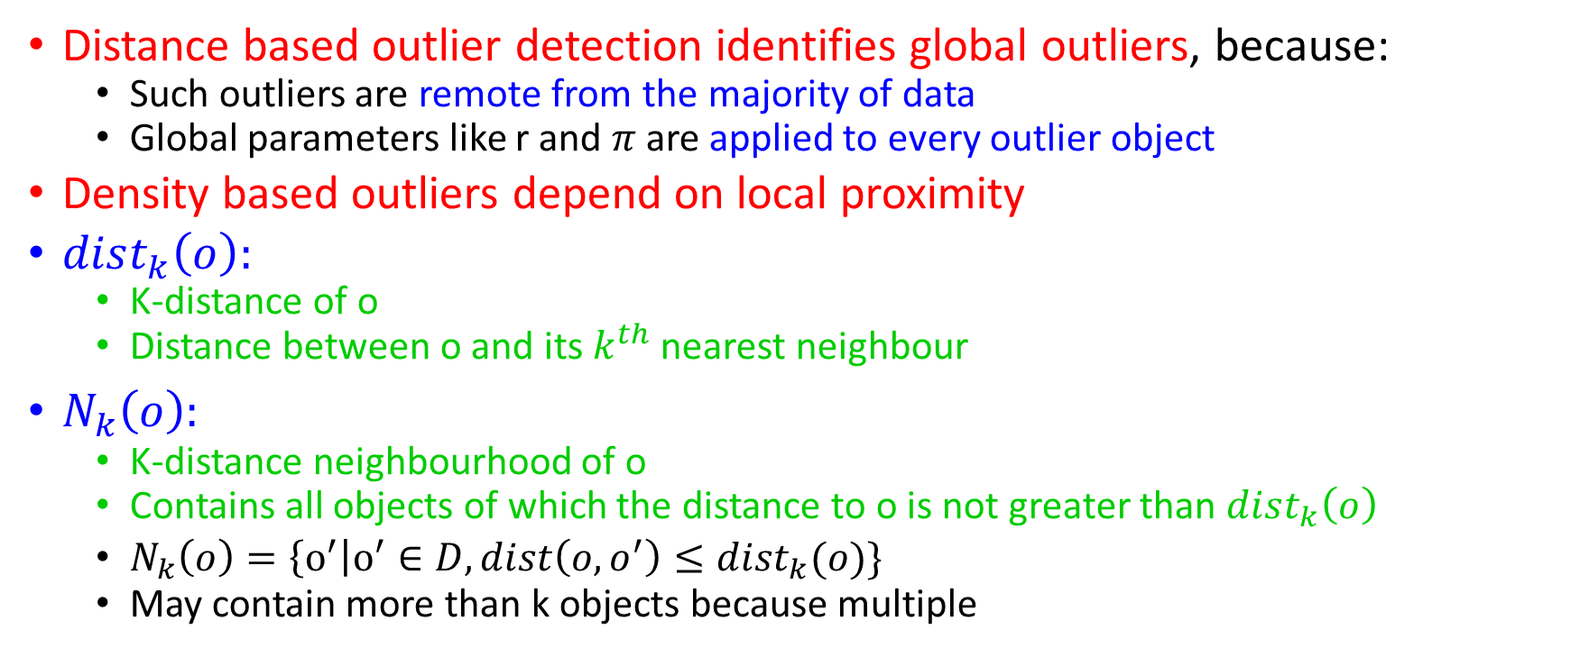
Density Based Outlier Detection
Distance based outlier detection identifies global outliers, because:
Such outliers are remote from the majority of data
Global parameters like r and $π$ are applied to every outlier object
Density based outliers depend on local proximity
$dist_{k}\left(o\right):$
K-distance of o
Distance between o and its $k^{th}$ nearest neighbour
$N_{k}\left(o\right):$
K-distance neighbourhood of o
Contains all objects of which the distance to o is not greater than $dist_{k}\left(o\right)$
$N_{k}\left(o\right)=\left\{o^{′}\right|o^{′}∈D, dist\left(o,o^{′}\right)≤dist_{k}(o)\}$
May contain more than k objects because multiple

Slide 51
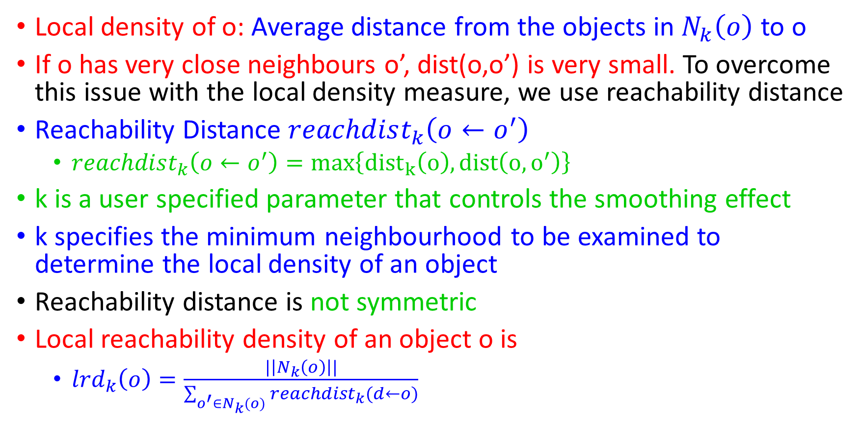
Local density of o: Average distance from the objects in $N_{k}\left(o\right)$ to o
If o has very close neighbours o’, dist(o,o’) is very small. To overcome this issue with the local density measure, we use reachability distance
Reachability Distance $reachdist_{k}\left(o←o^{′}\right)$
$reachdist_{k}\left(o←o^{′}\right)=max\left\{{dist}_{k}\left(o\right),dist\left(o,o^{′}\right)\right\}$
k is a user specified parameter that controls the smoothing effect
k specifies the minimum neighbourhood to be examined to determine the local density of an object
Reachability distance is not symmetric
Local reachability density of an object o is
$lrd_{k}\left(o\right)=\frac{|\left|N_{k}\left(o\right)\right||}{\sum_{o^{′}∈N_{k}(o)}{reachdist_{k}(d←o)}}$

Slide 52
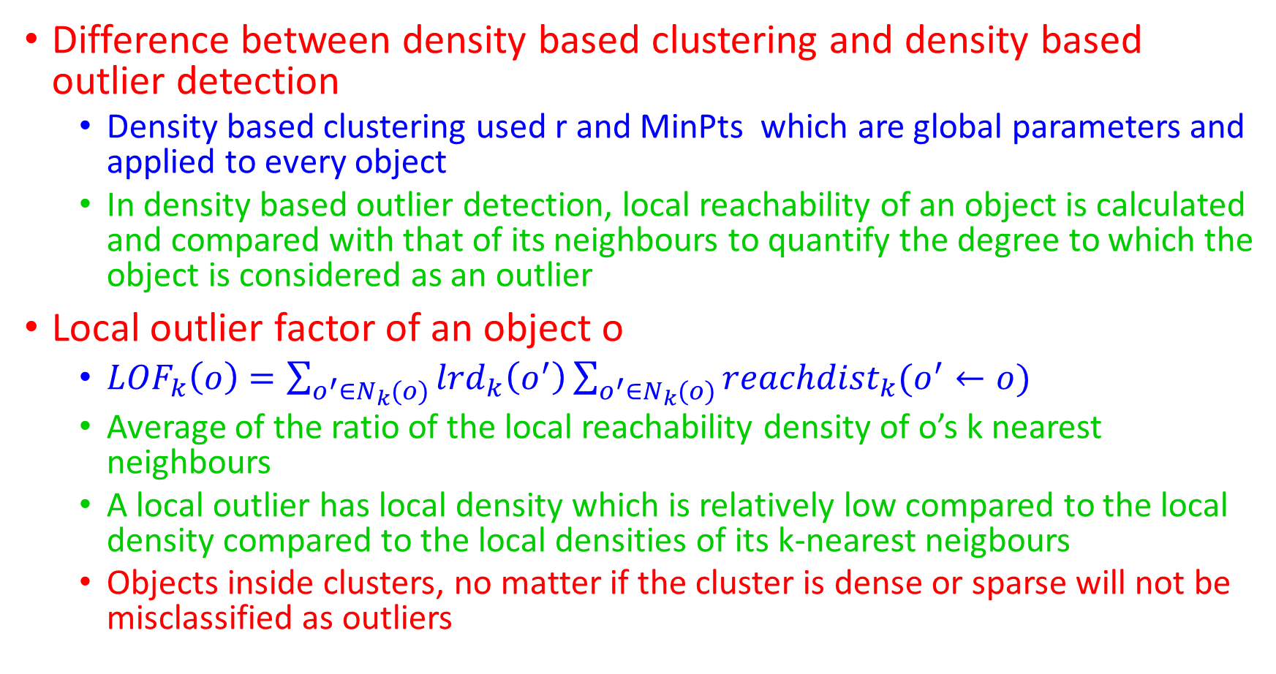
Difference between density based clustering and density based outlier detection
Density based clustering used r and MinPts which are global parameters and applied to every object
In density based outlier detection, local reachability of an object is calculated and compared with that of its neighbours to quantify the degree to which the object is considered as an outlier
Local outlier factor of an object o
$LOF_{k}\left(o\right)=\sum_{o^{′}∈N_{k}(o)}{lrd_{k}\left(o^{′}\right)\sum_{o^{′}∈N_{k}(o)}{reachdist_{k}(o^{′}←o)}}$
Average of the ratio of the local reachability density of o’s k nearest neighbours
A local outlier has local density which is relatively low compared to the local density compared to the local densities of its k-nearest neigbours
Objects inside clusters, no matter if the cluster is dense or sparse will not be misclassified as outliers

Slide 53
Clustering Based Approaches

Slide 54
General intuition: An outlier is an object that belongs to a small and remote cluster or does not belong to any cluster
General approaches to clustering based outlier detection methods:
Does the object belong to any cluster? If not, then it is identified as an outlier
Is there a large distance between the object and the cluster to which it is closest? If yes, it is an outlier
If the object, part of a small or sparse cluster? If yes, then all the objects in that cluster are outliers

Slide 55
Does the object belong to any cluster? If not, then it is identified as an outlier
Using a density based method like DBSCAN, we can identify the objects that do not belong to any cluster

Slide 56
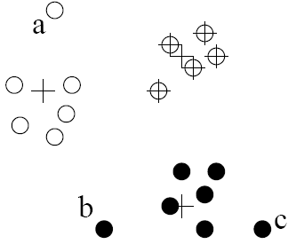
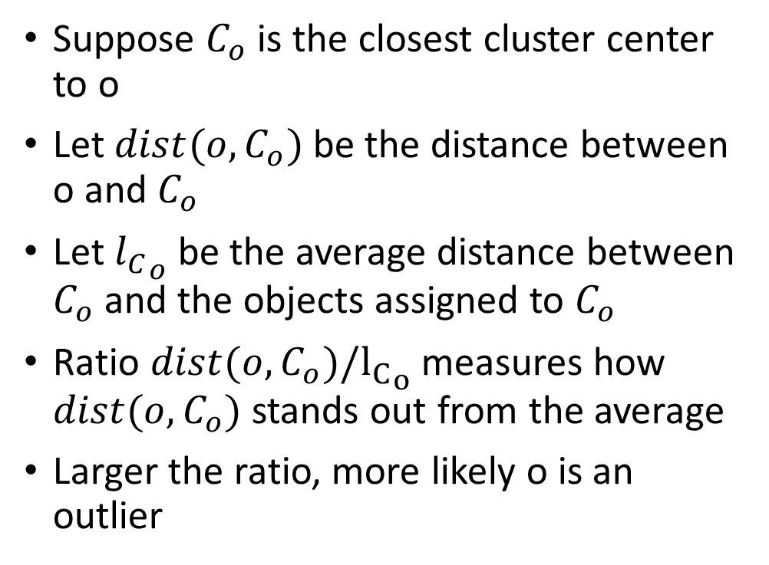
Is there a large distance between the object and the cluster to which it is closest? If yes, it is an outlier
Suppose $C_{o}$ is the closest cluster center to o
Let ${dist(o,C}_{o})$ be the distance between o and $C_{o}$
Let ${l_{C}}_{o}$ be the average distance between $C_{o}$ and the objects assigned to $C_{o}$
Ratio ${dist(o,C}_{o})/{l_{C}}_{o}$ measures how ${dist(o,C}_{o})$ stands out from the average
Larger the ratio, more likely o is an outlier

Slide 57
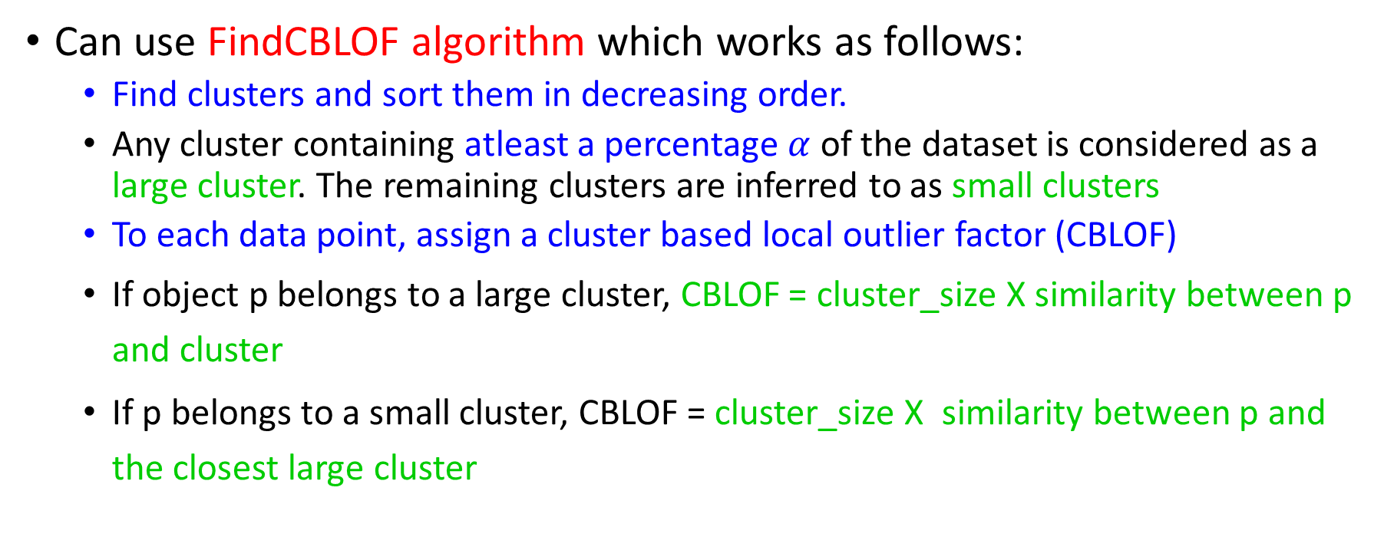
If the object, part of a small or sparse cluster? If yes, then all the objects in that cluster are outliers
Can use FindCBLOF algorithm which works as follows:
Find clusters and sort them in decreasing order.
Any cluster containing atleast a percentage $α$ of the dataset is considered as a large cluster. The remaining clusters are inferred to as small clusters
To each data point, assign a cluster based local outlier factor (CBLOF)
If object p belongs to a large cluster, CBLOF = cluster_size X similarity between p and cluster
If p belongs to a small cluster, CBLOF = cluster_size X similarity between p and the closest large cluster

Slide 58
o is outlier since its closest large cluster is C₁, but the similarity between o and C₁ is small. For any point in C₃, its closest large cluster is C₂ but its similarity from C₂ is low, plus |C₃| = 3 is small
CBLOF can detect outliers that are far from any clusters
CBLOF considers small clusters which are far from any of the large cluster s to consist of outliers
Points with the lowest CBLOF scores are considered as potential outliers

Slide 59
Problem:
High computational cost if clusters are to be considered as potential outliers
Solution: Fixed width clustering
Linear time technique
Point is assigned to a cluster if the center of the cluster is within a predefined threshold from the point
If a point cannot be assigned to any existing cluster, a new cluster is created
Advantages:
Do not require labels
Works for many data types
Clusters can be used as summaries to compare an outlier (faster comparison)
Weaknesses:
Effectiveness depends on clustering method used
Costly for large datasets

Slide 60
Classification Based Approaches

Slide 61
General Idea:
Train a classifier that can distinguish normal data from outliers
Brute Force Approach:
Training set consists of samples labeled as “normal” and “outliers”
Does not work well if there are insufficient outlier examples
Outlier Detection using a One Class Approach:
Classifier is built to describe only the normal class
Any samples that do not belong to the normal class are regarded as outliers

Slide 62
Outlier Detection by Semi Supervised Learning
Consider a cluster having some objects labeled and the remaining objects unlabeled
Assign the same label to the unlabelled objects and train a classification model
Need to incorporate expert domain knowledge in the classification model
Once the classification model is created, outlier detection is fast
Quality of the models depends on the availability and quality of the training set

